Slide 1
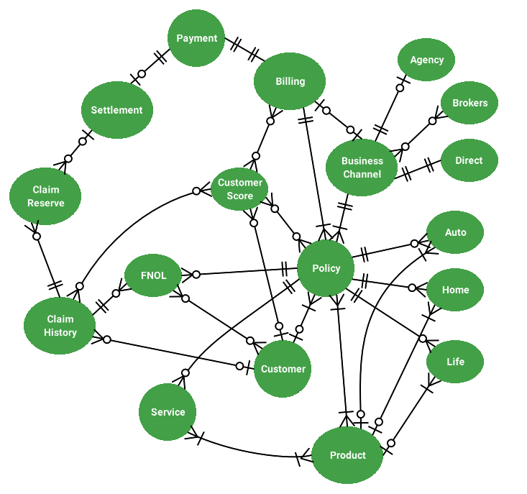




Part 1. Conceptual Business Model – Insurance Industry
Min to Max
Zero to One
Zero to Many
One to One
One to Many
Policy Types
The relationship between concepts are based on the max value between the two. For e.g.,
Product to Policy is Many to Many
Customer to Policy is One to Many
Billing to Payment is One to One

Slide 2
Part 2. Relational Data Model – Insurance Industry (a subset of conceptual model)
FNOL
FNOL_ID | <PK>
POLICY_NUMBER | <FK>
CUSTOMER_ID | <FK>
INCIDENT_DATE
INCIDENT_TIME
NUMBER_OF_INJURED
NUMBER_OF_WITNESS
LOSS_AMT
CREATED_BY
CREATED_ON
BRIEF DETAILS
M:1
POLICY
POLICY_NUMBER | <PK>
CUSTOMER_ID | <FK>
POLICY_TYPE_CODE | <FK>
PRODUCT_TYPE_CODE | <FK>
ZIP_CODE
POLICY_ADDRESS
START_DATE
END_DATE
TOTAL_PREMIUM
PRODUCT_TYPE_CODE
PAYMENT_FREQ
BILLING_NUMBER | <FK>
BUSS_CHANNEL_ID | <FK>
RENEWABLE (Y/N)
M:1
CUSTOMER
CUSTOMER_ID | <PK>
FIRST_NAME
MIDDLE_NAME
LAST_NAME
GENDER
DATE_OF_BIRTH
ZIP_CODE
POSTAL_ADDRESS
MARITAL_STATUS
EDUCATION
SOCIAL_SECURITY_NO
CONTACT_NO
CUST_SCORE_ID | <FK>
CLAIMS_HISTORY_ID | <FK>
1:M
1:1
M:1
M:N
CLAIMS_HISTORY
CLAIM_ID | <PK>
FNOL_ID | <FK>
INVESTIGATION_DATE
INVESTIGATOR EMP ID | <FK>
DAMAGE_TYPE
SETTLEMENT_AMT
SETTLEMENT_DATE
CUST_SATISFIED (Y/N)
CLAIM_RESERVE_ID | <FK>
PRODUCT
PRODUCT_TYPE_CODE | <PK>
POLICY_TYPE_CODE | <FK>
BASE_COVERAGE_AMT
BASE_PREMIUM_AMT
OTHER_SERVICES
1:M – One to Many
M:1 – Many to One
1:1 – One to One
M:N – Many to Many

Slide 3
Part 2. Primary Key Details of Relational Data Model
CUSTOMER Table:
Customer ID : Surrogate primary key
Social Security Number : Natural primary key (but not used as a Primary Key, could be a candidate key)
First Name + Middle Name + Last Name + Zipcode + Address : Composite natural primary key
POLICY table:
Policy Number: Surrogate primary key
PRODUCT Table:
Product Type Code: Surrogate primary key
FNOL Table:
FNOL ID : Surrogate primary key
Policy Number + Incident Date + Incident Time + Created On : Composite natural primary key
CLAIMS_HISTORY Table:
Claim ID: Surrogate primary key
All Foreign Key references are mentioned in the relational data model and relations are marked accordingly
(FNOL – First Notice Of Loss)

Slide 4
Part 2. Details About Source Systems
CUSTOMER Table: Customer Relationship Management (CRM) Systems, Web Management & Analytics Systems, External Source Systems (Credit Agencies)
POLICY table: Product Management Systems, Lead Management Systems
PRODUCT Table: Product Management Systems
FNOL Table: Customer Care Systems, Ticketing & Workflow Management Systems
CLAIMS_HISTORY Table: Technical Operations Systems, Product Management Systems

Slide 5
Part 3. SQL Queries:
Sometimes insurance companies would like to get an idea of gross profit per policy type, by end of the year. Find sum of premium of all the policies of each type that are terminating on or before 31st Dec 2020.
Answer:
select sum(TOTAL_PREMIUM) from POLICY
group by (POLICY_TYPE_CODE)
having END_DATE<= ‘31-12-2020’
Insurance companies are reluctant to renew a policy of a customer if the customer has high claim history record. Find the names of the customers who have been paid total claims more than $5000 for the incidents happened in the year 2020.
Answer:
select a.FIRST_NAME, a.MIDDLE_NAME, a.LAST_NAME, sum (b.SETTLEMENT_AMT) as TOTAL_CLAIMS
from CUSTOMER a, CLAIMS_HISTORY b, FNOL c
where a.CLAIMS_HISTORY_ID=b.CLAIM_ID and b.FNOL_ID=c.FNOL_ID and TOTAL_CLAIMS>5000 and c.INCIDENT_DATE between ’01-01-2020’ and ‘31-12-2020’

Slide 6
Part 4: Sensitive data and data quality issues:
A. Data Sensitivity Issues:
PII: In CUSTOMER table, Social Security Number is a Personal Identity Information. Also, (Name + Address + DOB) combined together could be a PII.
CFI: The data table for PAYMENT would contain bank a/c number, card number and other related financial details. These are CFI. Also, CUSTOMER_SCORE table holds data like Credit Score from bank, Car driving score from FICO, LexisNexis etc., claims history score from other insurance company are direct or indirect financial information.
CPNI: Our system does not have any CPNI data.
PHI: The Policy for type ‘Life Insurance’ would contain data of present health condition of the insured, past medical record which are PHI.

Slide 7
Part 4: Sensitive data and data quality issues:
B. Data Quality Issues:
The free form text field ‘Postal Address’ in Customer table and ‘Policy Address’ in Policy table, and ‘Brief Details’ in FNOL table might cause challenges, as these are entered by end users and might be insufficient or abbreviated.
Contact No, SSN, Zip-Code might be entered wrongly, these fields should have validation check for correct format at the time of input.
Policy End Date cannot be in past compared to Start Date. If validation check not done at the time of policy creation, and it flows to downstream system, it might cause problems in premium calculation and billing.
Validation check should be imposed while entering Incident Date in FNOL table, it should be between Policy Start Date and End Date, otherwise invalid.
Also, Loss Amount (claimed) entered in FNOL cannot be greater than Coverage Amount of the Policy.

